Slide 1






T-cell repertoire analyses in immunotherapy treated patients
S. Simon^{1,2,3}, V Voillet², V Vignard^{1,3,4}, Z Wu⁵, A. Khammari^{1,3,4}, O Adotevi⁶, S. Rulli⁵, R. Gottargdo², P Nghiem⁷, B. Dreno^{1,3,4}, A. Riddell², N. Labarrière^{1,3} nathalie.labarriere@inserm.fr
¹ University of Nantes, Inserm, CRCINA, F-44000 Nantes, France
² Fred Hutchinson Cancer Research Center, Seattle, USA
³ LabEx IGO “Immunotherapy, Graft, Oncology”, Nantes, France
⁴ CHU of Nantes, Nantes, France
⁵ Qiagen Sciences, Frederick MD, USA
⁶ University Bourgogne Franche-Comté, INSERM, EFS BFC, UMR1098 , France
⁷ Division of Dermatology, Department of Medicine, UW School of Medicine, Seattle, WA, USA

Slide 2
Abstract
Clinical benefit from PD-1 inhibitors relies on reinvigoration of endogenous anti-tumor immunity. Nonetheless, robust immunological markers, based on circulating immune cell subsets associated with therapeutic efficacy are yet to be validated.
We documented that the frequency of circulating PD-1+TIGIT+ (DPOS) CD8+ T-cells after 1 month of anti-PD-1 therapy was associated with clinical response. This DPOS T-cell population was enriched in highly activated T-cells, tumor-specific and emerging T-cell clonotypes and T lymphocytes overexpressing CXCR5, a key marker of the CD8 cytotoxic follicular T cell (Tfc) population. Additionally, transcriptomic profiling defined a specific gene-signature for this population as well as the over-expression of specific pathways associated with the therapeutic response.
Our results provide a convincing rationale for monitoring this PD-1+TIGIT+ circulating population as an early cellular-based marker of therapeutic response to anti-PD-1 therapy.

Slide 3
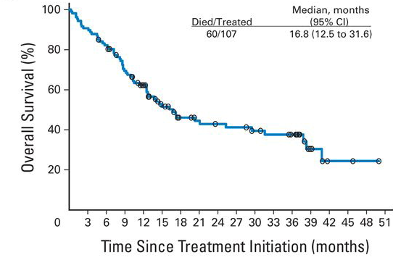
Introduction
A large fraction of patients did not respond to anti-PD-1 monotherapy
(Topalian et al. 2014)
Defining markers predictive of anti-PD-1 response or resistance

Slide 4

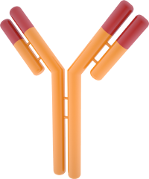
Introduction
S. Simon
Immune mechanisms ongoing
under anti-PD-1 therapy
The entire preexisting anti-tumor T cell repertoire
is a potential target of anti-PD-1 therapy
Proof of concept study : variations within the blood CD8 T cell repertoire specific
for the shared Melan-A antigen

Slide 5
Introduction
PD-1
Melan-A specific T cells
Evolution of Melan-A specific T cell repertoire upon PD-1 blockade in melanoma patients?
αPD-1 mAb

Slide 6
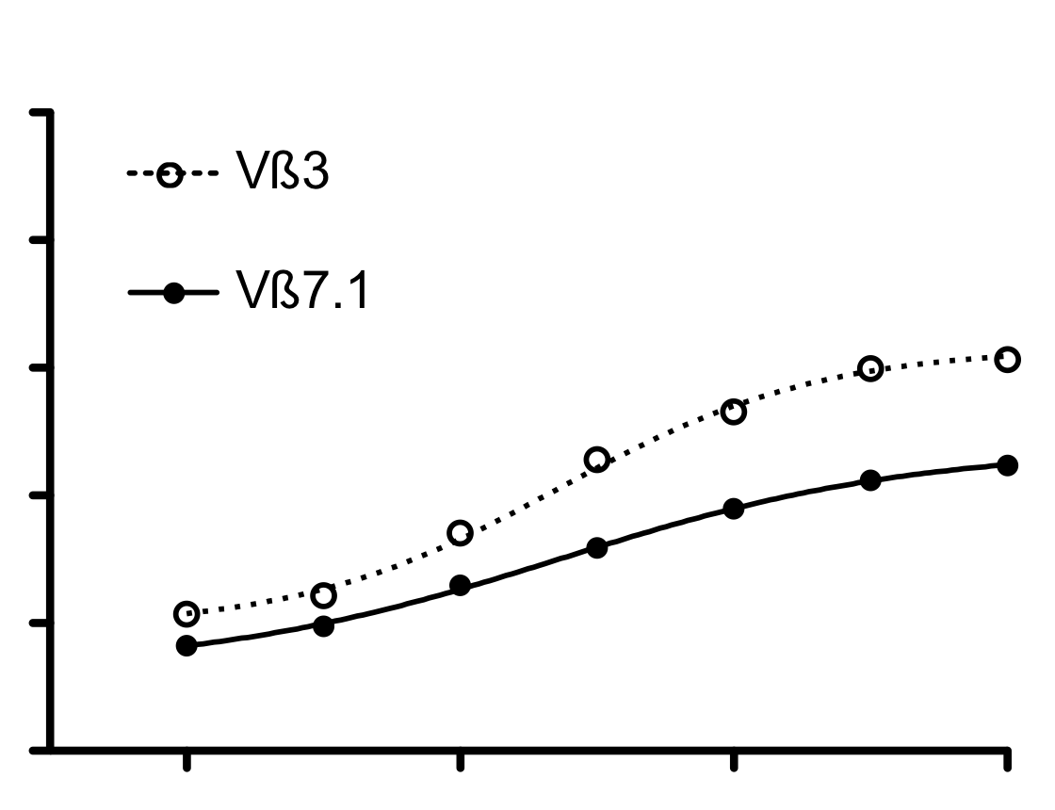
Introduction
PD-1
Melan-A specific T cells
Evolution of Melan-A specific T cell repertoire upon PD-1 blockade in melanoma patients?
αPD-1 mAb
Responders
Stable disease
Progressor
100
100
100
80
80
80
60
60
60
% CD107a positive cells
% cellules CD107a positives
40
40
40
20
20
20
-4
-2
0
2
-4
-2
0
2
-4
-2
0
2
Log peptide concentration (nM)
Neo-clonotype: high functional avidity
Dominant within Melan-A repertoire
Neo-clonotype: high functional avidity
Less dominant within Melan-A repertoire
Weak functional avidity
No neo-clonotypes

Slide 7
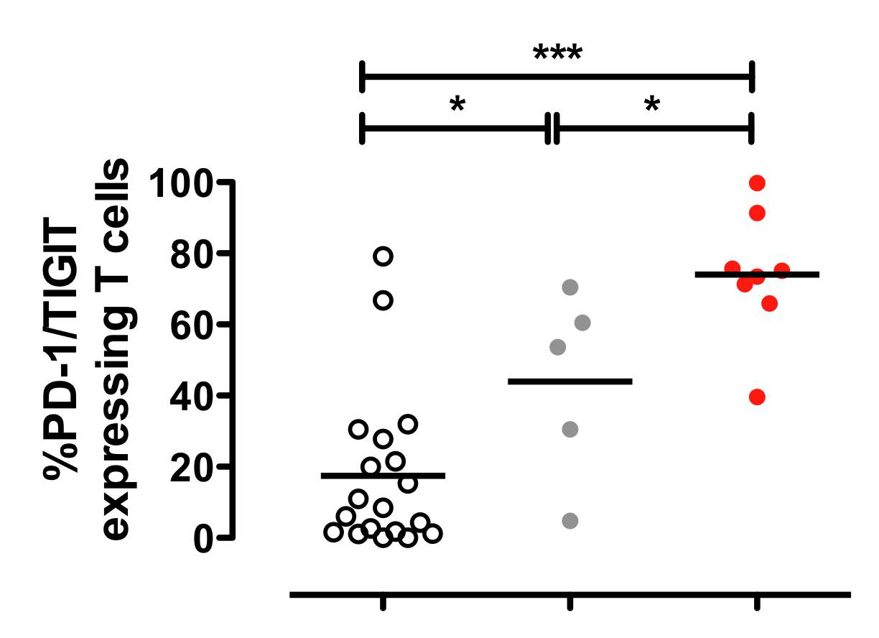
Introduction
PD-1
Melan-A specific T cells
Evolution of Melan-A specific T cell repertoire upon PD-1 blockade in melanoma patients?
αPD-1 mAb
Melan-A specific neo-clonotypes can be identified by the co-expression of PD-1 and TIGIT markers
T0
M2

Slide 8
Introduction
PD-1
Melan-A specific T cells
Evolution of Melan-A specific T cell repertoire upon PD-1 blockade in melanoma patients?
αPD-1 mAb
Melan-A specific neo-clonotypes can be identified by the co-expression of PD-1 and TIGIT markers
T0
M2
CD8 T cells with high functional avidity (PD-1^{high}) are a target of anti-PD-1 therapy
The emergence of Melan-A specific neoclonotypes seems
to reflect anti-PD-1 therapeutic efficacy
PD-1 and TIGIT coexpression identifies neo-clonotypes with high functional avidity

Slide 9
Materials and Methods
(Simon, J Immunother Cancer in revision)
Clinical evaluation
Melanoma patients
D0
M1
M2
M6
anti-PD-1 (n=13)
Frequencies of sorted T cells
T cell reactivity
HLA-A2 patients
Selected melanoma peptides
Amplification on
feeder cells
Sorting of the 4 T cell fractions :
TCRαβ+ CD3+ CD8+ PD-1+/- TIGIT+/-
RNA extraction
Comprehensive phenotypic evaluation
Qiagen TCR Panel QIAseq™ Immune Repertoire RNA Library Kit
QIAseq Targeted RNA Custom Panel
TCR repertoire comparison
T0, M1, M2 and M6
RNAseq comparison
T0, M1, M2 and M6

Slide 10
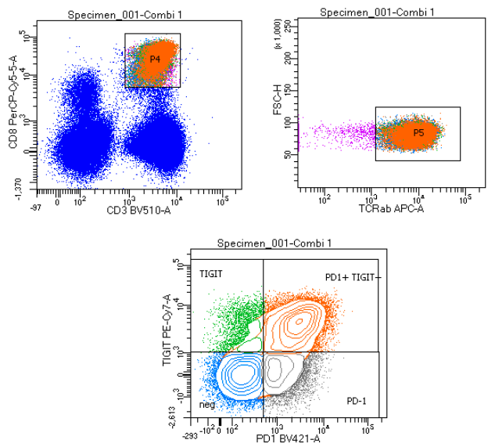
Results : Frequency of DPOS T cells
Sorting of the T cell fractions:
TCRαβ+ CD3+ CD8+ PD-1+ TIGIT+
CD8
TIGIT
CD3
TCRab
PD1

Slide 11
Results : Frequency of DPOS T cells
Sorting of the T cell fractions:
TCRαβ+ CD3+ CD8+ PD-1+ TIGIT+
TIGIT
PD1

Slide 12
Results : Frequency of DPOS T cells
Sorting of the T cell fractions:
TCRαβ+ CD3+ CD8+ PD-1+ TIGIT+
TIGIT
PD1
2 melanoma patients cohorts treated with Nivolumab (n=26)
NR
R
Frequency of DPOS PD-1⁺/TIGIT⁺ CD8⁺ after 1 month of anti-PD-1 is associated with therapeutic responses

Slide 13
Results : Frequency of DPOS T cells
Sorting of the T cell fractions:
TCRαβ+ CD3+ CD8+ PD-1+ TIGIT+
TIGIT
PD1
2 melanoma patients cohorts treated with Nivolumab (n=26)
NR
R
Frequency of DPOS PD-1⁺/TIGIT⁺ CD8⁺ after 1 month of anti-PD-1 is associated with therapeutic responses and overall survival

Slide 14
Results : Frequency of DPOS T cells
Sorting of the T cell fractions:
TCRαβ+ CD3+ CD8+ PD-1+ TIGIT+
TIGIT
PD1
2 melanoma patients cohorts treated with Nivolumab (n=26)
NR
R
Frequency of DPOS PD-1⁺/TIGIT⁺ CD8⁺ after 1 month of anti-PD-1 is associated with therapeutic responses and overall survival
→ Phenotype, specificity and T cell repertoire?

Slide 15
Results : phenotype of DPOS T cells
Higher expression of PD-1 on DPOS T cells : highly activated T lymphocytes
(Nat Med 2018 in TIL from NSCLC)

Slide 16
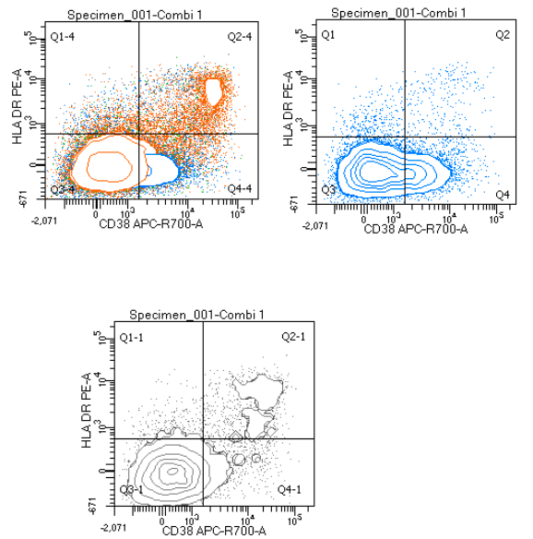
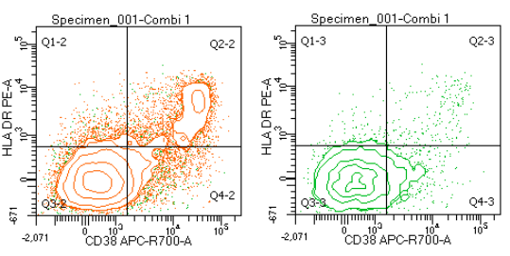
Results : phenotype of DPOS T cells
Higher expression of PD-1 on DPOS T cells : highly activated T lymphocytes
(Nat Med 2018 in TIL from NSCLC)
DNEG
PD-1
DPOS
TIGIT
2.4%
11%
18%
5%
Higher expression of HLA-DR/CD38 (Ki67): proliferating T lymphocytes
(Kamphorst Nature 2017 et PNAS 2017)

Slide 17
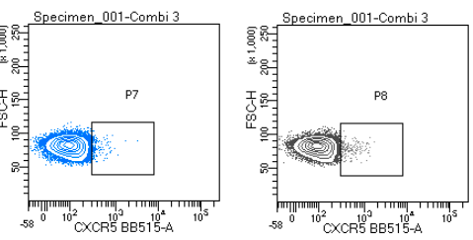
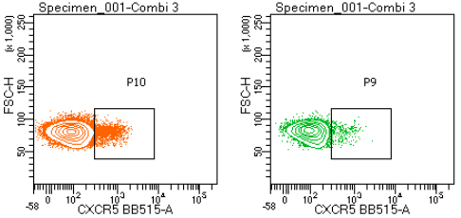
Results : phenotype of DPOS T cells
Higher expression of PD-1 on DPOS T cells : highly activated T lymphocytes
(Nat Med 2018 in TIL from NSCLC)
DNEG
PD-1
DPOS
TIGIT
2.4%
11%
18%
5%
Higher expression of HLA-DR/CD38 (Ki67): proliferating T lymphocytes
(Kamphorst Nature 2017 et PNAS 2017)
DNEG
PD-1
DPOS
TIGIT
0.8
1.6
6
3.7
Enriched in CXCR5+ : Tch-like

Slide 18
Results : Transcriptomic features of DPOS T cells
Targeted transcriptome : 975 genes

Slide 19
Results : Transcriptomic features of DPOS T cells
Targeted transcriptome : 975 genes
Cytokine-cytokine
receptor interaction
Gene signature: 12 genes up-regulated in the DPOS fraction: activation, chemokines, metabolism
Inflammatory response
IFN-α signaling via NFκB
Epithelial-mesenchymal transition

Slide 20
Results : Antigen specificity of DPOS T cells
- Reactivity of the 4 sorted T cell subsets on 11 peptides derived from tumor antigens (Kvistborg, Oncoimmunol 2012)
T0
M1
DNEG
PD-1
DPOS
TIGIT
Number of responses

Slide 21
Results : Antigen specificity of DPOS T cells
- Reactivity of the 4 sorted T cell subsets on 11 peptides derived from tumor antigens (Kvistborg, Oncoimmunol 2012)
T0
M1
DNEG
PD-1
DPOS
Enrichment and diversity of peptide-specific T cell responses in the DPOS fraction, after 1 month of anti-PD-1 therapy
TIGIT
Number of responses

Slide 22
Results : T-cell repertoire of DPOS T cells
TCR sequencing on the 4 T-cell fraction at baseline and M1
4 clusters :
Clonotypes émergents
Clonotypes amplifiés
Clonotypes contractés
Clonotypes stables

Slide 23
Results : T-cell repertoire of DPOS T cells
TCR sequencing on the 4 T-cell fraction at baseline and M1
- T cell repertoire evolution according to clinical outcome
Significantly higher frequency of emerging clonotypes in the DPOS fraction, after 1 month of therapy, in responding patients

Slide 24
Conclusion
Circulating T-cell subset CD8+ PD-1^{hi}/TIGIT^{hi} :
Frequency after 1 month of treatment associated with clinical outcome
Enriched in activated T cells, and CXCR5+ T-cells
Enriched in antigen-specific T cells
Enriched in emerging clonotypes
  This population contains recirculating activated clonotypes
  Potential systemic immune marker of anti-PD-1 efficacy

Slide 25



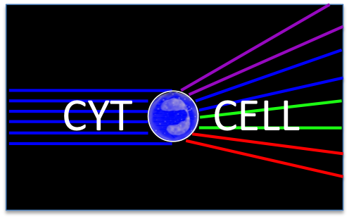

Collaborators
Team 3 « Anti-tumor immunosurveillance and immunotherapy » (Nantes)
Onco-dermatology Unit
(Nantes)
Qiagen (Washington)
TCR sequencing
Patient’s samples
and clinical data
Brigitte Dreno
Amir Khammari
Julie Cassecuel
Camille Dabrowski
Sam Rulli
Zhong Wu
Nathalie Labarrière
Sylvain Simon
Houssem Benlalam
Céline Bossard
Anne Jarry
Catherine Rabu
Cécile Deleine
Virginie Vignard
Agnès Fortun
Romain Oger
Nicolas Jouand
Linda Bilonda Mutala
Emilie Dupré
Lucine Marotte
TCR seq bioinformatic
analyses
Cytometry facility CYTOCELL (SFR Santé)
(Nantes)
Fred Hutch (Seattle)
Muliparametric
analyses and cell sorting
Nicolas Jouand
Nadège Marec
Juliette Desfrançois
Stanley Riddell
Sylvain Simpn
Valentin Voillet
Raphaël Gottardo

